Slide 1
Tutorial PSM with Python
WEEK 5 – MATCHING METHODS
2022-23925 Syalianda Salsabila Izzati
2022-25172 Lee Sooin

Slide 2


OUTLINE
Introduction: The Psychology of Growth
Data Description
Normal Linear Regression
Selection Bias
Propensity Score Estimation
Logistic Regression
Linear Regression using PSM
Easier way to implement C.I.
Result of using “CausalModel”

Slide 3
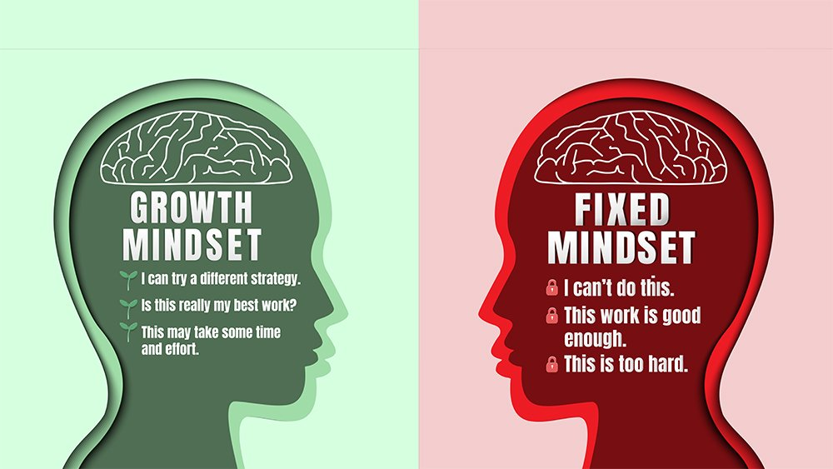

INTRO
What is Growth Mindset?

Slide 4
Fixed Mindset vs. Growth mindset
Fixed Mindset
Growth mindset
Abilities are given at birth or in early childhood
Should not waste time on areas where you don’t excel.
Wants to prove intelligence or talent
Traits as stable and unchangeable
Intelligence can be developed
Your failure is not as lack of tenacity, but lack of practice
Want to improve intelligence or talent
Traits as learnable and changeable

Slide 5
Research Question
Is it that a growth mindset causes people to achieve more?
OR
Is simply the case that people who achieve more are prone to develop a growth mindset as a result of their success?

Slide 6
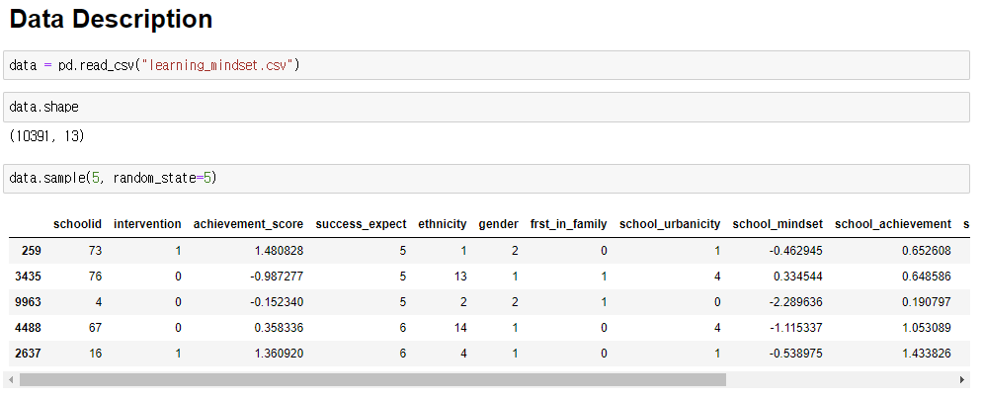
Data Description
Treatment (T) : Students can choose to attend seminar about “Growth mindset”. (Intervention)
Dependent Variable (Y): How well they’ve performed academically (Achievement score)

Slide 7
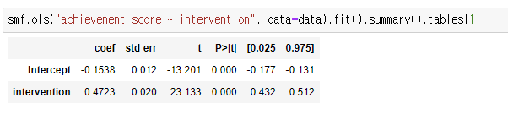
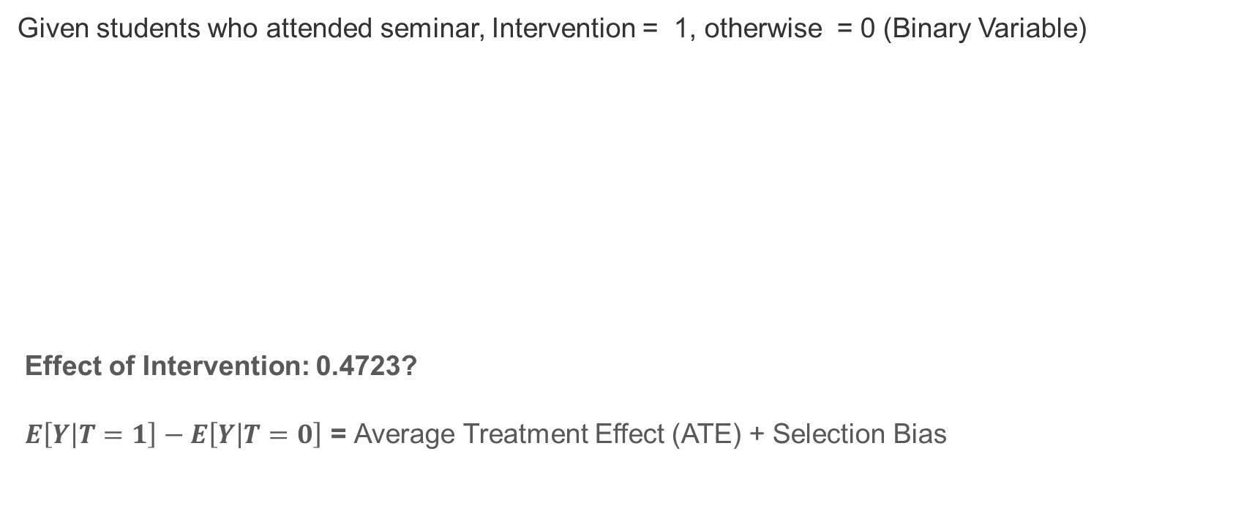
Normal Linear Regression
Given students who attended seminar, Intervention = 1, otherwise = 0 (Binary Variable)
Effect of Intervention: 0.4723?
$E\left[Y | T=1\right]−E\left[Y | T=0\right]$ = Average Treatment Effect (ATE) + Selection Bias

Slide 8
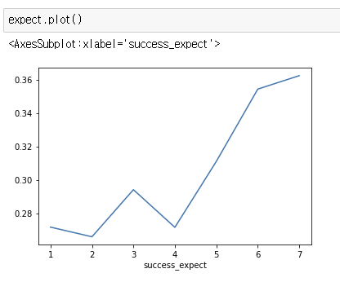
Selection Bias
Positive Bias
Success expectation vs. Intervention
Did students who attended the seminar got higher achievement score? (Treatment Effect)
Or as more ambitious students are more willing to go to the seminar, even if they had not attended it they probably would have higher achievement score more. (Selection Bias)
Notes:
The difference between treated and untreated is probably smaller, as think the bias might be positive.

Slide 9
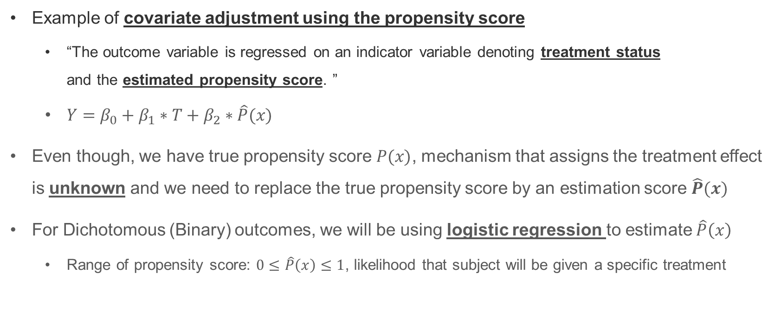
Propensity score estimation
Example of covariate adjustment using the propensity score
“The outcome variable is regressed on an indicator variable denoting treatment status and the estimated propensity score. ”
$Y=β_{0}+β_{1}∗T+β_{2}∗\hat{P}(x)$
Even though, we have true propensity score $P(x)$, mechanism that assigns the treatment effect is unknown and we need to replace the true propensity score by an estimation score $\hat{P}(x)$
For Dichotomous (Binary) outcomes, we will be using logistic regression to estimate $\hat{P}\left(x\right)$
Range of propensity score: $0≤\hat{P}\left(x\right)≤1$, likelihood that subject will be given a specific treatment

Slide 10
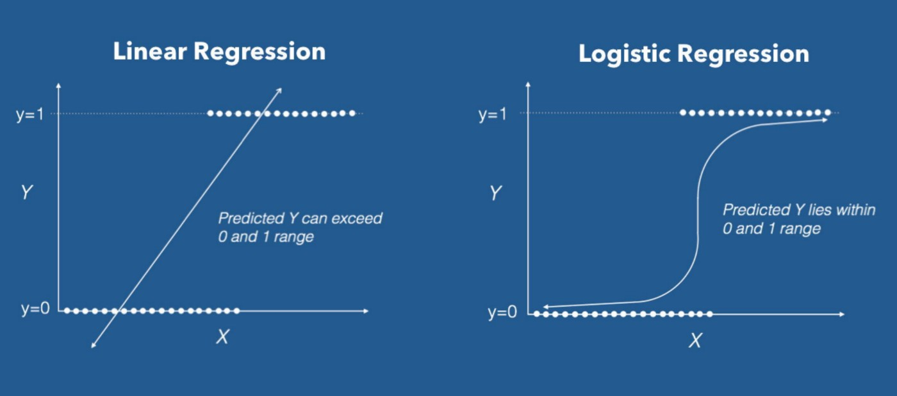
Linear vs. Logistics

Slide 11
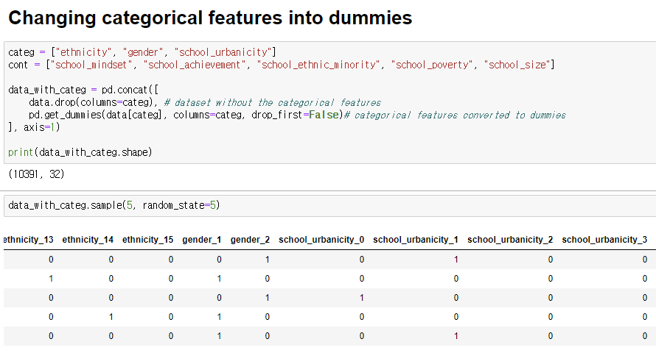
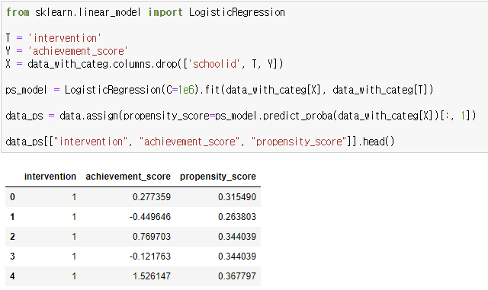
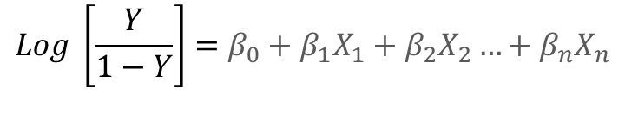
Process of Estimation
Changing into dummies
Estimated propensity score
$$Log \left[\frac{Y}{1−Y}\right]=β_{0}+β_{1}X_{1}+β_{2}X_{2}…+β_{n}X_{n}$$

Slide 12
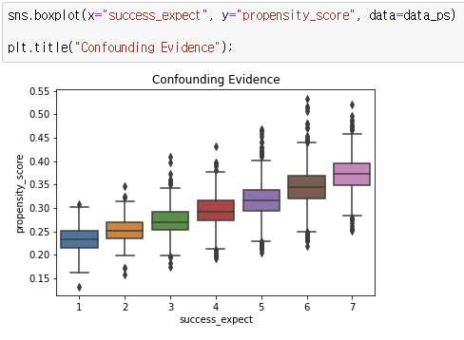
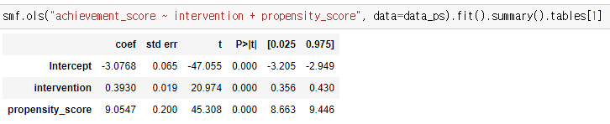
Linear Regression using PSM
Success expect & Propensity score
Linear Regression with P.S
Intervention Effect: 0.472 → 0.393

Slide 13
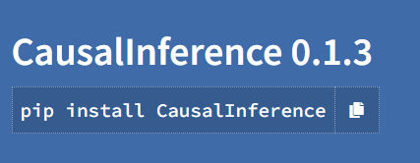
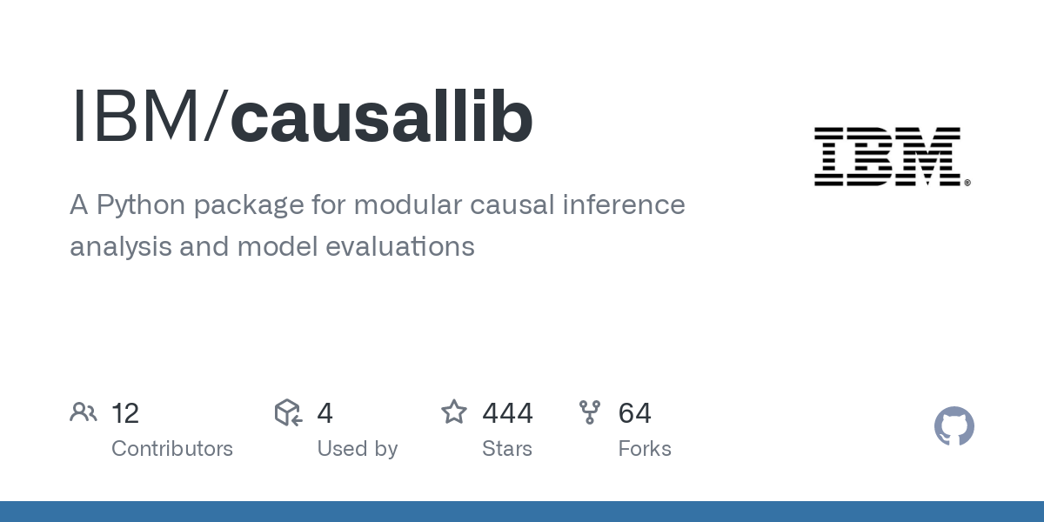
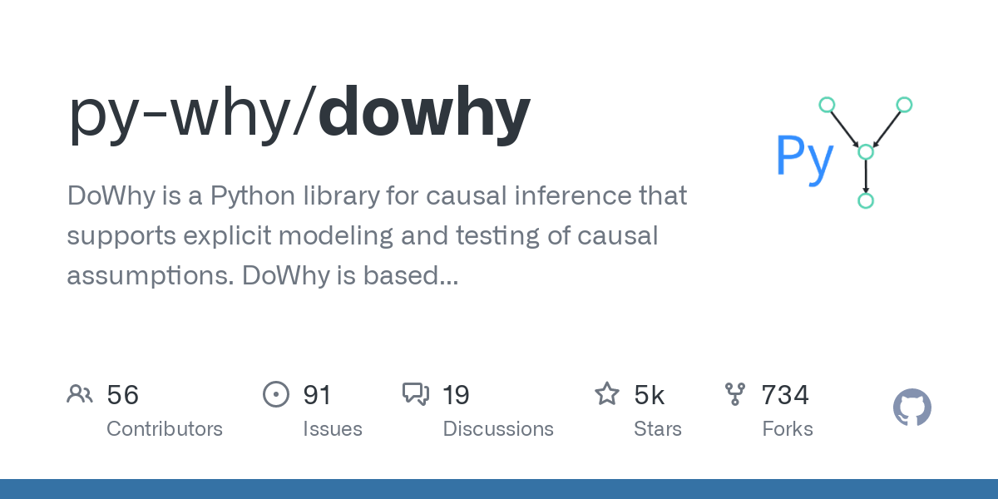
Easier way to implement C.I.
Causal inference
Causallib
doWhy
Python package provides various statistical methods
Simple package used for basic causal analysis learning
Python package developed by IBM
Provide causal analysis API unified with Scikit-Learn API
Python package provides 4-step interface for causal inference
Integration with EconML library

Slide 14
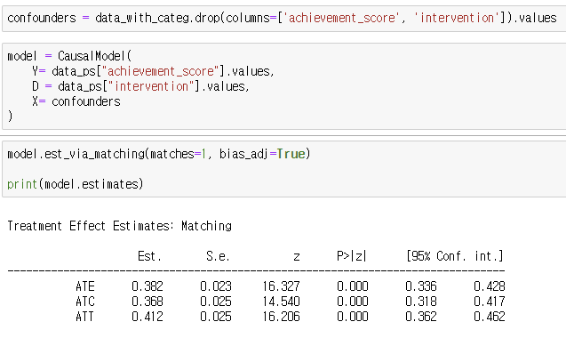
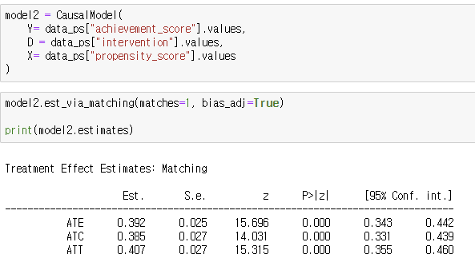
Result of using “CausalModel”
Actual ATE
Estimated ATE using PSM

Slide 15
THANK YOU
https://matheusfacure.github.io/python-causality-handbook/11-Propensity-Score.html

